Slide 1
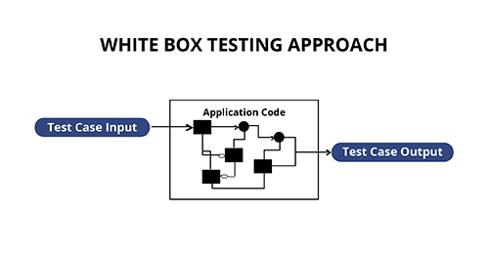
White-Box Testing Techniques
Software Testing

Slide 2
Objectives
How to perform white box testing, and tools and techniques relevant to white box testing
Explore the most common and effective techniques for white-box
Testing, including:
  Basis Path Testing
  Branch Testing
  Loop Testing
  Control-flow Criteria

Slide 3
White-box testing
Definition
  Analyzing the algorithm implementation (code) to derive test cases
Common types
  Function, statement , block
  Decision/branch, condition
  Basis path
Criteria
  Risk assessment / reduction
  Augment test coverage / code coverage

Slide 4
Why structural testing
Optimal
In order to find a bug we:
must reach the line containing the fault
must provide the data/conditions to execute the fault
Must allow the fault to propagate
target %
Coverage
n%
n%
Black box
approach
0%
or
Unknown
Time / Effort

Slide 5
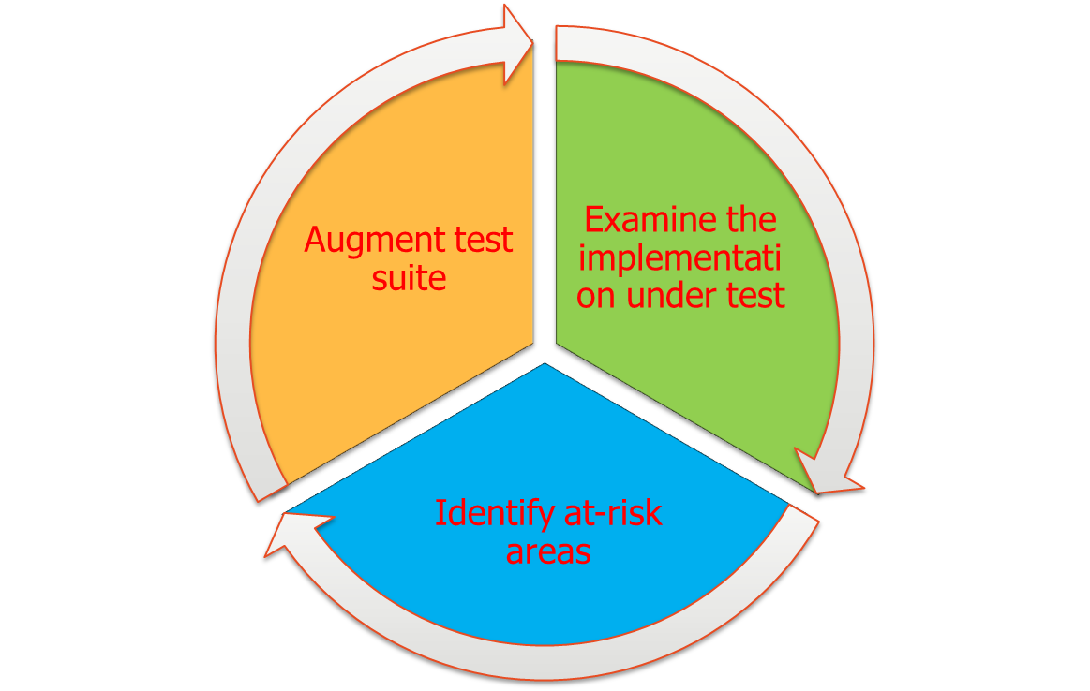
Structural testing

Slide 6
Basic white box testing
Function
  Execute each function in a program at least once
Statement
  Execute each statement in a program / function at least once
Block
  Execute each contiguous “block” of statements in a program / function at least once

Slide 7

Function, statement, block coverage
private void ExitMenuClick(object sender, EventArgs e)
{
Application.Exit();
}
private bool IsInvalidTriangle(UInt16 a, UInt16 b, UInt16 c)
{
if ((a + b <= c) || (b + c <= a) || (a + c <= b))
{
return true;
}
return false;
}

Slide 8
Function, Statement, block testing
Advantages
  Easy to measure
  Easy to automate (unit test generators)
  Provides confidence is basic functionality
Disadvantages
  Weakest criterion for structural testing
  May not cover all possible paths
  Provides false sense of confidence

Slide 9
Decision testing
Definition
  Every statement in the program has been executed at least once, and every logical decision in the program has been evaluated to both possible outcomes
  A logical decision is a simple Boolean conditional expression

Slide 10

Decision/branch testing
Evaluates simple Boolean expressions
Most effective for:
  Simple conditional expressions
  Loops
internal static bool IsUpperCaseLatinCharacterA (char c)
{
if (c == ‘A’) {
return true;
}
return false;
}

Slide 11

Example: Control flow
Control flow graph
  Aid to trace execution paths through a program / function.
A1
A1 public static int CharIndex(string str, char c)
{
int i = 0;
int retVal = 0;
char[] s = str.ToCharArray();
A2 while ((i < s.Length) && (s[i] != c))
{
i++;
}
A3 if (i < s.Length)
{
retVal = i;
}
return retVal;
A4 }
A2
A3
A4

Slide 12
Example: Switch statement
A1
... // other stuff
A1 switch(wParam)
{
A2 case VK_UP:
MoveUp(hWnd);
break;
A3 case VK_DOWN:
MoveDown(hWnd);
break;
A4 case VK_LEFT:
MoveLeft(hWnd);
break;
A5 case VK_RIGHT:
MoveRight(hWnd);
break;
A6 }
... // other stuff
A2
A3
A4
A5
A6

Slide 13
Example: Exception handling
A1
A1 public bool ConvertToInteger(string input, ref int output)
{
try
{
A2 output= Convert.ToInt32(input);
}
A3 catch (OverflowException, e)
{
MessageBox.Show (e.Message);
return false;
}
A4 catch (FormatException, e)
{
MessageBox.Show (e.Message);
return false;
}
return true;
A5 }
A2
A3
A4
A5

Slide 14
Practice: Decision coverage
Create control flow diagram, define tests
internal static decial GetCommission(int locks, int stocks, int barrels)
{
decimal sales = GetTotalSales(locks, stocks, barrels);
decimal commission = 100;
if (CommissonIsDue(locks, stocks, barrels)) {
if (sales > 1800) {
commission += (800 * Bonus15);
commission += ((sales - 1800m) * Bonus20);
}
else if (sales > 1000) {
commission += ((sales - 1000m) * Bonus15);
}
else {
commission = (sales * standardCommission);
}
}
return commission.ToString();
}

Slide 15
Loops
A1
A1 private static bool IsThirtyDayMonth(int month)
{
int[] shortMonth = new int[4] { 4, 6, 9, 11 };
A2 for (int i = 0; i < shortMonth.Length; i++)
{
A3 if ( month == shortMonth[i])
{
return true;
}
}
return false;
A4 }
A2
A3
A4

Slide 16
Loop Testing
Minimal tests include
  Skip loop
  Iterate through loop one time
  Maximum number of loop iterations
  Watch for overflows / out of range errors
Nested or Compound loops
  Test innermost loop first and work outwards
  Outer loops held to minimal iteration values as allowed

Slide 17
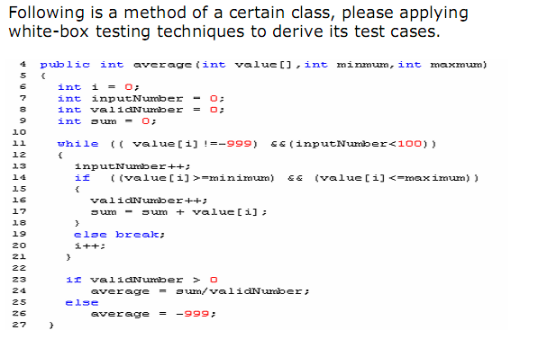
Applying White-Box Testing
Techniques

Slide 18
Decision coverage summary
Advantages
  Includes statement coverage by default
  Each Boolean expression tested for TRUE and FALSE outcomes
  Sufficient coverage for switch statement cases, exception handlers, and interrupt handlers
Disadvantages
  Doesn’t consider logical operators in compound conditions
  Doesn’t test all combinations of Boolean expressions

Slide 19
Condition testing
Definition
  Testing each conditional expression in a compound decision statement
  Provides increased sensitivity to control flow compared to simple decision testing

Slide 20
Example: Condition testing
A1
A1 private bool IsInValidDate (int month, int day, int year)
{
A2 A3
if ((year == 1582 && month == 10) &&
A4 A5
(day >= 5 && day <= 14))
{
return true;
}
return false;
A6 }
A2
Assumes short-circuiting
Does not evaluate relational operators
A3
A4
A5
A6

Slide 21
Practice: Condition testing
Assume valid integer inputs for params a, b, and c
A0 private void GetTriangle (int a, int b, int c)
{
A1, A2, A3 if (!(a + b > c) || !(b + c > a) || !(a + c > b))
{
// Error
}
A4, A5 else if ((a == b) && (b == c))
{
// Equilateral;
}
A6, A7, A8 else if ((a == b) || (b == c) || (a == c))
{
// Isoceles;
}
else
{
// Scalene;
}
A9 }

Slide 22
Condition coverage summary
Advantages
  Condition coverage includes statement, decision/ branch coverage
  Verifies true and false arc combinations
Disadvantages
  Doesn’t exercise all possible combinations of compound Boolean expressions
  Does not exercise all linearly independent (basis) paths
  More difficult to achieve compared to decision/branch coverage

Slide 23
Flow Graph
A flow graph is G=(V, E), defined as follows:
  V = {vb, ve} U D U S, where
1. indegree(vb)=0 is the beginning vertex
2. outdegree(ve)=0 is the ending vertex
3. D is the set of atomic binary decision vertices and
4. S is the set of sequential vertices, each of which denotes a block of sequential statements
E⊆DXD U DXS U SXD is the set of directed edges

Slide 24
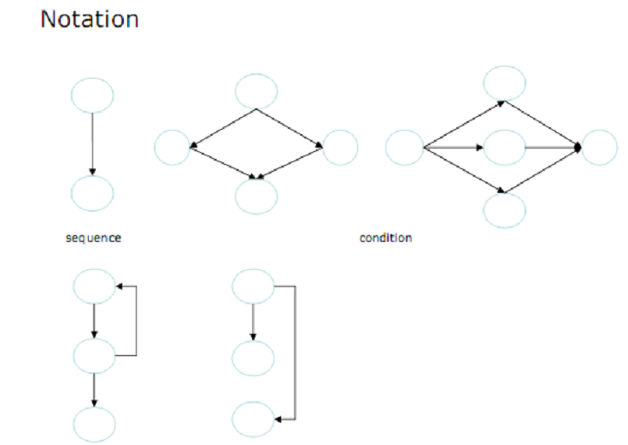
Flow graph

Slide 25
Cyclomatic Complexity
Definition
  Cyclomatic complexity of the flow chart indicates the number of independent paths of the program.
Formula
1. Number of closed regions including the surrounding rectangle+1
2. Number of binary predicate + 1.
3. Number of edges - Number of Nodes + 2.

Slide 26
Basis Path
Definition
  A path p is a sequence of vertices, p=vb, v1, v2, ..., vn, ve such that {<vb, v1>, <v1, v2>, ..., <vn, ve>} ⊆ E
  A path p=vb, v1, v2, ..., vn, ve is a basis path if p does not contain two subsequences s1, s2 such that s1=s2 and length(s1)>1 and length(s2)>1
  subseq(s1,p) <=> (∃s0)(∃s2)(s0,s1,s2 = p)
 A More Practical Definition
  Each basis path covers at least one edge not covered by other basis paths and exercises a cycle either zero times or exactly once.

Slide 27
Basis Path Testing
Steps
  1. Construct a flow graph based on a program’s decision logic.
  2. Compute cyclomatic complexity of the flow graph.
  3. Determine basis paths..
  4. Design test cases to go through these basis paths.

Slide 28
Baseline path method
Simple approach to identify basis paths
  Find the shortest path from entry to exit
  Return to the function entry point
  Change the conditional expression to its alternate outcome
  Follow shortest path to the exit point
  Repeat until all basis paths are defined
  Identify data to execute paths

Slide 29
Example: Basis path testing
A1
A1 internal static int GetMaxDay(int month, int day, int year)
{
int maxDay = 0;
A2 if (!IsInvalidDate(month, day, year)) {
A3 if (IsThirtyOneDayMonth(month)) {
maxDay = 31;
}
A4 else if (IsThirtyDayMonth(month)) {
maxDay = 30;
}
else {
maxDay = 28;
A5 if (IsLeapYear(year)) {
maxDay = 29;
}
}
return maxDay;
A6 }
A2
A3
A4
A5
A6

Slide 30
Practice: Basis path coverage
The objective of this exercise is to:
  Define the minimum number of tests for basis path coverage of a simple algorithm
In this exercise you will:
  Create a control flow diagram
  Design white box tests for decision coverage
  Calculate cyclomatic complexity
  Design white box tests for basis path coverage
This is important because:
  Basis path coverage is important for critical functions

Slide 31
Practice: Basis path testing
A1 static int CountC(string s)
{
int index = 0; int i = 0; int j = 0; int k = 0;
char[] strArray = s.ToCharArray();
A2 if (strArray[index] == 'A')
{
A3 while (++index < strArray.Length)
{
A4 if (strArray[index] == 'B')
{
j = j + 1;
k = 0;
}
A5 else if (strArray[index] == 'C')
{
i = i + j;
k = k + 1;
j = 0;
}
}
i = i + j;
}
else
{
return -1;
}
return i;
A6 }

Slide 32
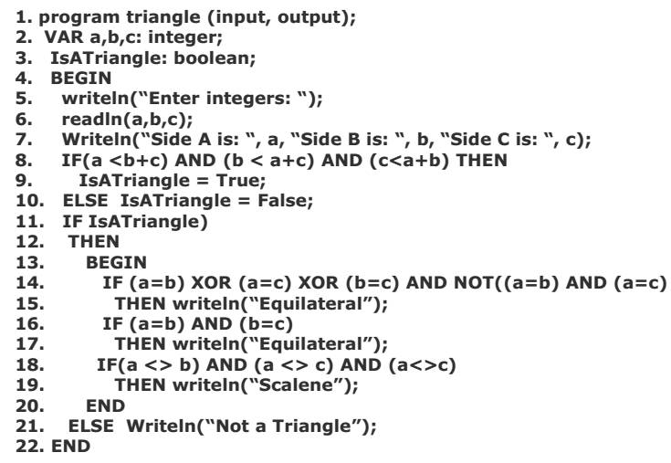
Practice

Slide 33
Basis path testing summary
Advantages
  Provides sufficient path coverage
  Includes decision and condition coverage
  Easy to determine minimum # of tests
Disadvantages
  Does not test all possible paths
  Not all orderings of arcs are feasible
  Doesn’t include loop coverage

